Slide 1
GIT INRODUCTION
Pavel Weber
Steinbuch Centre for Computing

Slide 2
What’s git
Development started in 2005
Distributed Version Control System
You don’t need to run server
Initially written in C by Linus Torvalds
Widely used nowadays
…. The Linux philosophy is “laugh in the face of danger”. Oops. Wrong one. “Do it yourself”. That’s it.

Slide 3
What’s git for?
Primarily for source code management
Track changes
Check the project history
Compare versions
Create branches and workflows
Retrieve old versions
Local version controlling
No central repository needed
Don’t need to wait for network presence to do a commit.
Each developer has the full repo of the project

Slide 4
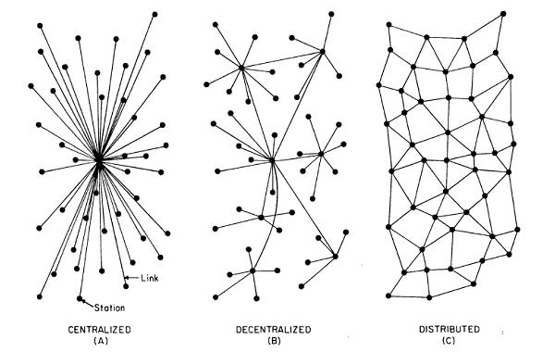
Why Git?
Distributed source control
Fast and efficient
Scalable and extensible
Multi-protocol support ( SSH, HTTP, Git)
Different working scenarios:
Single developer, central server, master, hierachy
Subversion/CVS

Slide 5
Get started
Environments: git config ……
Goto wiki
Exercise 1
Examine the config files
Apply configuration
Implement new aliases
/etc/gitconfig1
/etc/gitconfig
--system
~/.gitconfig
--global
~/repo/.git/config

Slide 6
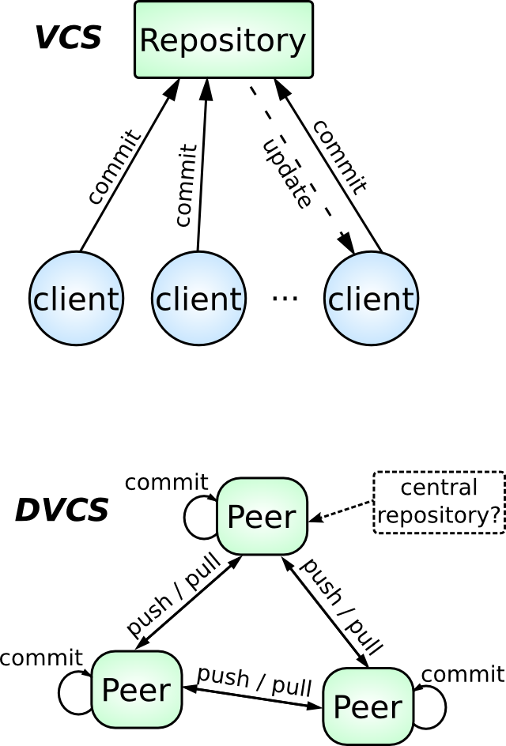
Central vs. Distributed

Slide 7
Git trees in local repository
Working directory/tree
Staging area/Index
Local repo
Each commit contains the full working tree

Slide 8
Git Add, Commit, Reset
git add – add the file to staging area or index
git reset – undo adding a file to index, move the file back to working tree
Git local repo
Different add options:
git add *
git add .
git add --all
git add -u
git add <file path>
g
git reset
Working directory/tree
Staging area/Index
Local repo
git add
git commit
git add --all stages All
git add . stages new and modified, without deleted
git add -u stages modified and deleted, without new
Exercise 2
Create local repo
Add file and commit

Slide 9
Working Tree, Index, Head
Working Tree - the state of files in checkout.
BRANCH - line of commits
HEAD - current branch or last committed state on current branch
INDEX - place, where the files which will be committed are stored
git checkout id
HEAD
Commit
Commit
Commit
Commit
Commit
last
Master

Slide 10
Git Dataflows
Working directory/tree
Staging area/Index
Local repo
Remote repo
git add
git commit
git push
git commit - a
git fetch
Pull or rebase
git reset
git checkout HEAD
git merge

Slide 11
Remote repo
Remote central repo
Local repo 1
Local repo 2
Exercise 3:
Add remote repository to your local repo with clone or with remote add
Try push, pull

Slide 12
Git Fetch, Rebase, Pull
git fetch - updates the local copy of remote repository
git rebase undo the local changes -> apply the remote -> do the local on top of applied remote
git pull - fetch + merge – applies the changes from remote on top of local
Remote
GIT REBASE
GIT PULL
Local
After git rebase:
After git pull:

Slide 13
Branches
What is branch
Why we need branches?
How to make a branch
How to switch between branches
Pushing to branch
Merging back to master
Deleting a branch locally
Deleting a branch remotely

Slide 14
Using branches: example
Master
Dev
Tests
Merge request
feature/issue

Slide 15
Branches
A branch is simply a pointer to a commit
Create a new branch:
git branch <new branch> [<start point>]
Delete a branch:
git branch -d | -D <branch> (-D also deletes unmerged branches)
Rename a branch:
git branch -m <old name> <new name>
Delete remote branch:
Git push origin :<branch>
List all branches
git branch [-r|-a]
Move into (checkout) a branch
git checkout <branch>
Create a branch and check it out
git checkout -b <branch>
Merge branches:
git merge < branch>

