Slide 1
SCC – mission and vision
Visit at HSS lab

Slide 2
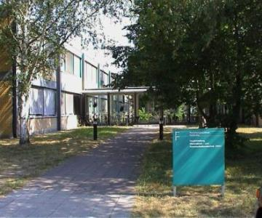
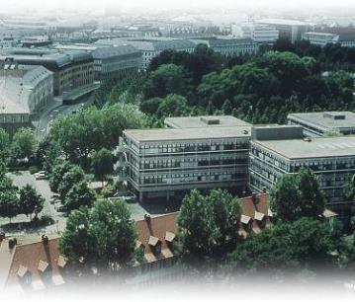


Steinbuch Centre for Computing
Computer Centre of the Karlsruhe Institute of Technology
IT for the University Campus
  6000 staff , 20000 students
Research
Data Management, Data Analysis and secure IT Federations
  Large Scale Data Management & Analysis
  GridKa
  Federated Identity Management
Computational Science and Engineering
  High Performance Computing
  Simulation Laboratories
Dynamic IT Infrastructures
  Cloud Computing
  Virtualisation
  Web Engineering
  IT and Service Management
Operation of large facilities
Campus North
Campus South

Slide 3


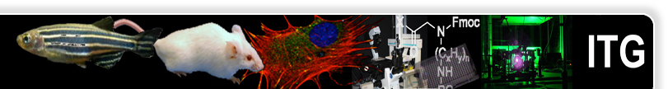
Large Scale Data
GridKa – LHC Tier 1 centre since 2002
  Supporting all 4 LHC experiments
  Currently 14 PB storage, 16000 cores, 10 Gb/s networking
  Operations and software dedicated to physics off-line computing
  Using gLite grid middleware
Large Scale Data Facility (LSDF) since 2009
  Support for data intensive computing for (in principle) all
  sciences
  Biology, Materials research, Climate research
    Storage for Baden-Wuerttemberg
  4.5 PB storage, 500 cores computing, 10 – 100 Gb/s networking
HPC for KIT and Baden-Wuerttemberg
  3 HPC Systems ranging from 30 to 135 Tflops, 300 TB Storage

Slide 4
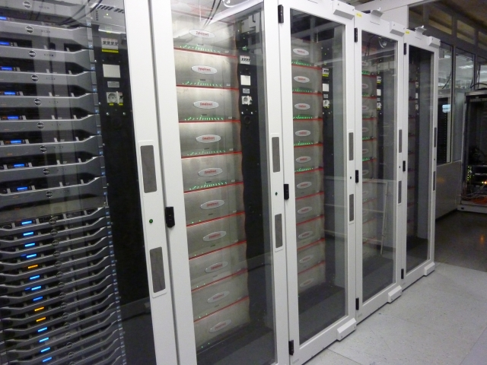
Fact sheet
GridKa
  SA9900, SFA10K
  GPFS in multiple clusters (500 – 1000 TB)
  xrootd and dCache, CVMFS, for storage management
LSDF
  SFA12K, DS5300
  GPFS and SONAS
  Industry standard protocols
HPC
  SA9900 HPC Online storage
  Shared FS with 2 clusters
  Lustre

Slide 5
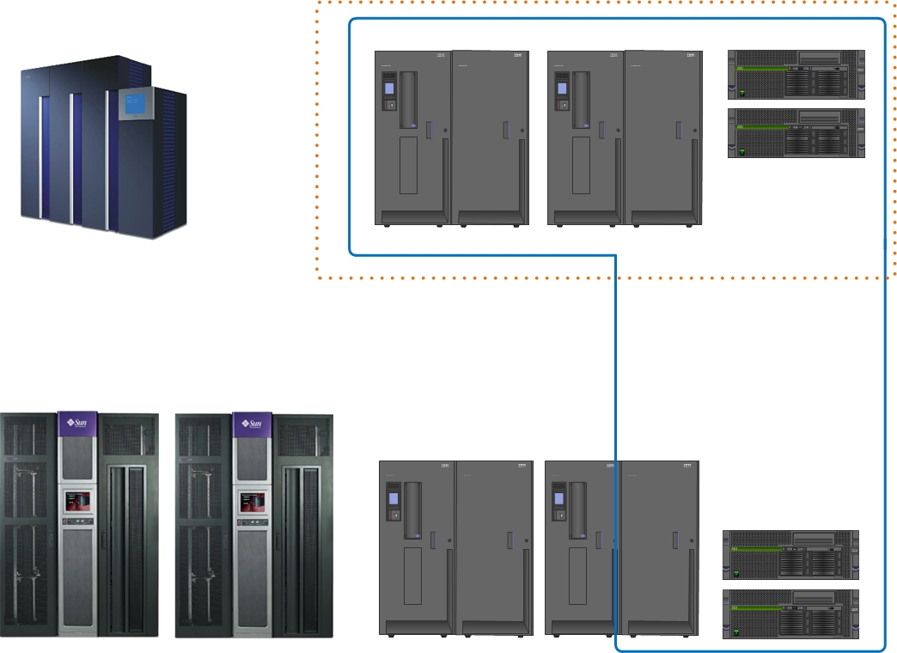
tape env
Campus South
Grau XL 5300 slots, LTO3, LTO4
STK 01, 10000 slots 16 LTO4, 12 LTO5
KIT Backup
STK 02, 10000 slots, 10 LTO5, 2 T10Kd
8400 slots, 22 LTO5
6000, 24 LTO4

Slide 6
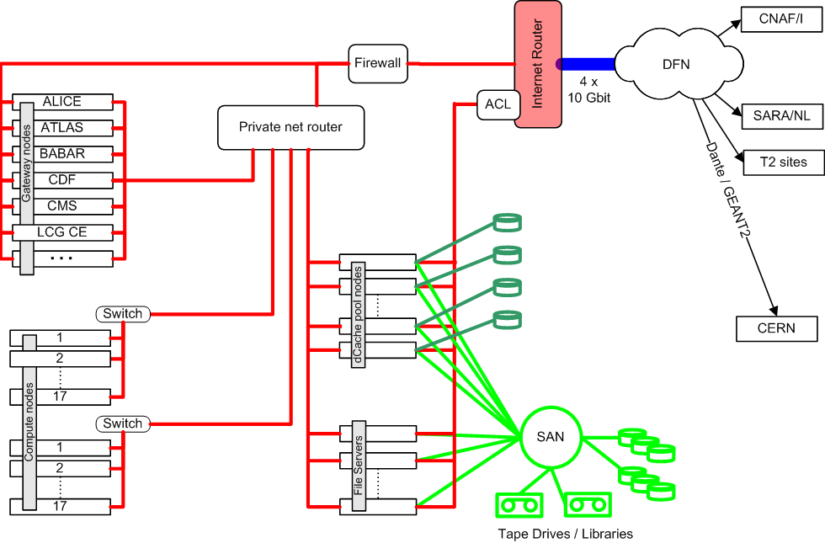

gateway nodes
Compute nodes
storage nodes

Slide 7
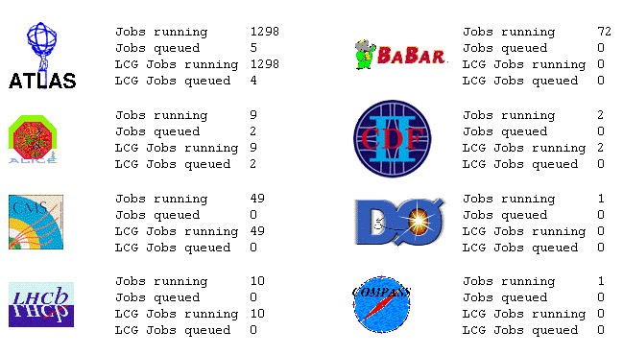

Slide 8
Data (reduction) in HEP
Detector data
  RAW - tracks, hits : size ~2.5MB
    needs reconstruction
  RECO - detailed reconstructed info, particles
    suitable for detector studies and reconstruction code development
  AOD - most used objects for analysis
    (Analysis Object Data)
    this is what end scientists use to run their jobs.
  Skims - selected channels for focused research groups and individual scientists
    they are just pointers to AOD objects
  Ntuples - suitable for download to laptop and to run ntuple analysis (apply selections, cuts)
Calibration and condition data
  must be available at every job
  side band data flow using distributed databases
Data reduction chain
Relative sizes of
data tiers
RAW
RECO
0.2 of RAW
AOD
0.2 of RECO
not to scale !

Slide 9
Storage in WLCG / GridKa
Based on dCache and xrootd
Data management framework is VO specific
SRM based access to on-line and archive storage
WAN access via GridFTP and managed by FTS
VO specific Data Management
File Transfer Service (FTS)
Compute Elements
SRM
GridFTP
dCache
xrootd
Transfer
MetaData
File system
(GPFS)
Tape system
(TSM/ermm)
File system
(GPFS)
FS/cache
MetaData
Tape
Physical disk
Physical disk

Slide 10
What is dCache?
Think of it as file system (with some restrictions)
Unified name space
Disk pool management: unifies several storage units into one
Data is distributed on a number of servers with disk pools
Load balancing and hot spot detection
Support for HSM backend
Development DESY(Deutsches Elektronen-Synchrotron) and FNAL(Fermi National Accelerator Laboratory)

Slide 11
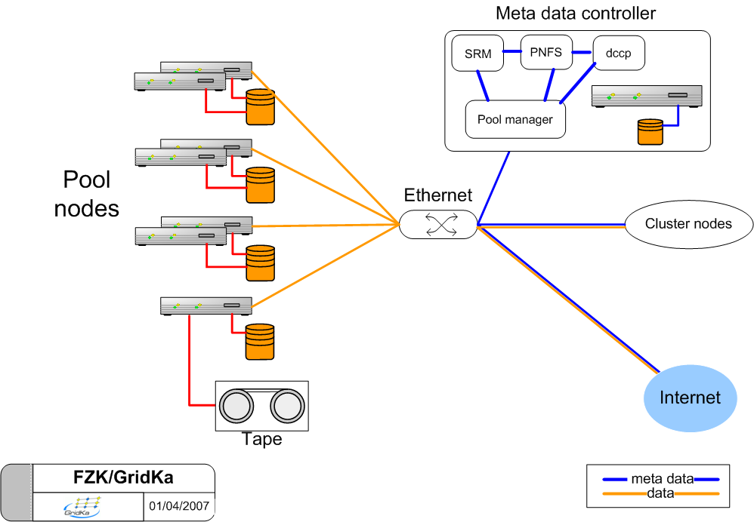
dCache architecture
Disk pool nodes
Tape pool node
dCache
TSS
TSM storage agent
GPFS

Slide 12
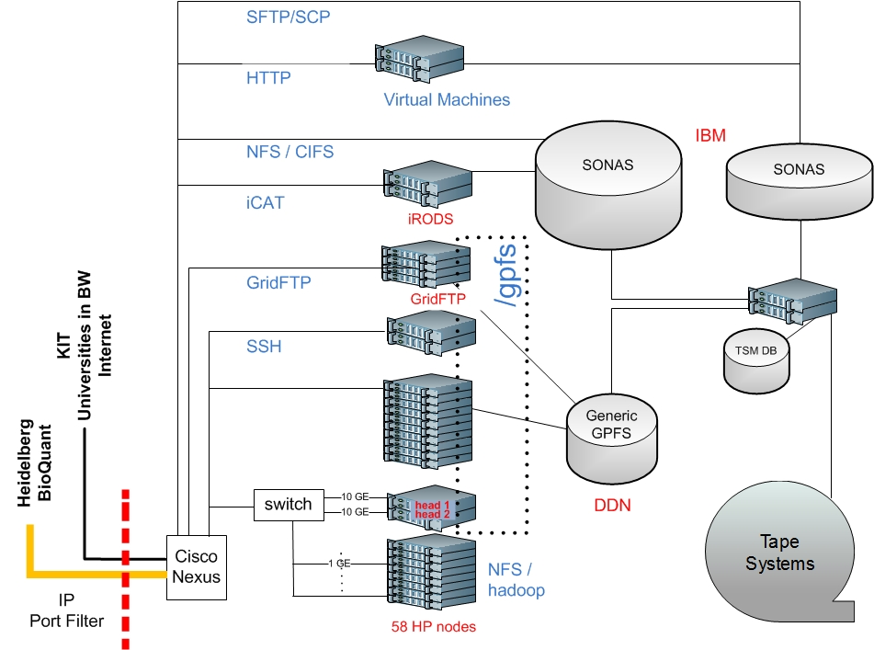

Slide 13
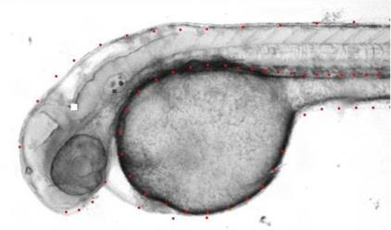
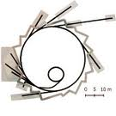
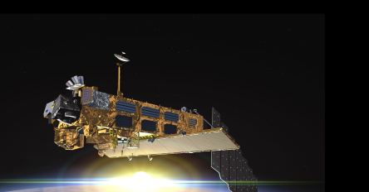

LSDF Data
Biology
  High Throughput Microscopy 1000 TB/year
  Gene Sequencing 50 TB/year
  PByte archives for partner institutes
Synchrotron radiation (ANKA)
  Various experiments
  200 TB/year (2013) - 1000 TB/year (2014)
Climate research
  Various experiments (rate stays flat)
  150 TB/year (archive until 2026!!)

Slide 14
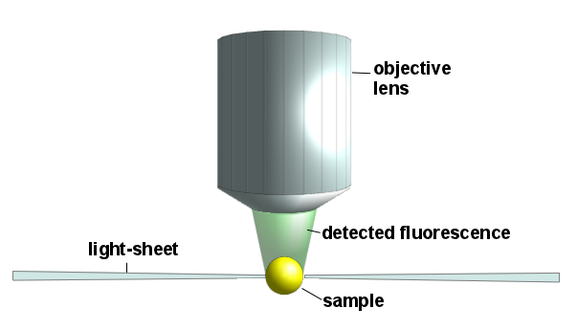
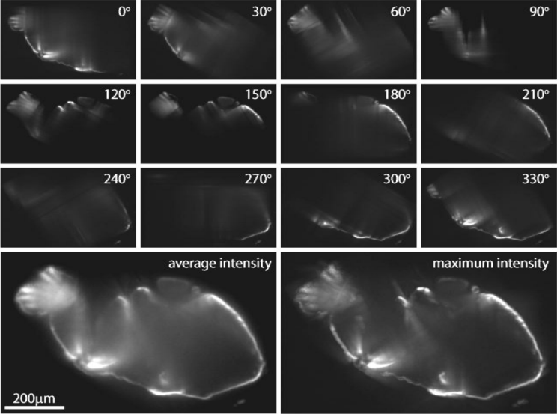
Application: Light Sheet Microscopy
Novel microscope to observe zebra fish embryos in vivo:
Very high 3D resolution
Short data acquisition time
Each day one observation of the development of an embryo:
Data: 7 TB/10 h → expected ~ 300 TB
Challenges:
  Meta data extraction
  Data transfer source to LSDF > 250 MB/s
  Data intensive analysis < 24 h: registration, fusion, segmentation, tracking, statistics
Source: Uroš Kržič,
Multiple-view microscopy with light-sheet based fluorescence
microscope, Dissertation, Heidelberg, 2009

Slide 15
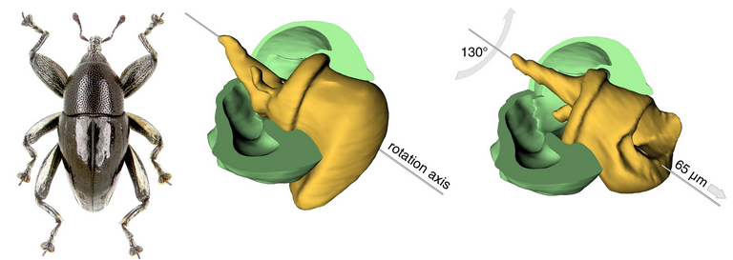
Application: Ultra-Fast Tomography
Spatio-temporal observations
Interactive 3D reconstructions based on tomographic volumes
Development of
  data management components within the ANKA beam line and the LSDF,
  online analysis based on GPGPU,
  novel reconstruction algorithms
Synchrotron ANKA
LSDF
UI
UI
UI
Control System
DAQ
Online
Analysis
Meta/Data Ingest
Storing
Schedule
Processing
Parallel
Computing
Result
Analysis
Ultra-fast tomography data set : 500 GB
courtesy: Rainer Stotzka KIT/IPE

Slide 16


Connection to tape
backends needed for
  dCache: GridKa
  xrootd: GridKa
  iRODS: EUDAT, HBP
All these call backend scripts
  uses get put del primitives
  eg. dCache “put”
exec("$TSS", "--migrate", "--class=$CLASS", "$desc", \ "$DSKFNAM", "/$STORE/$GROUP/$PNFSID");

Slide 17
Data flow to the T1 - with dCache and SRM
Open channel
SRM soap
messages
SRM
client
SRM
server/door
dCache
TSM
GridFTP
Control channel
GridFTP
client
GridFTP
server/door
Class 1
TSS
Class 2
GridFTP
Data Channel(s)
Class 3
dCache Pool
Class n
OPN/Firewall
Queueing
(on space token description)
Other Grids
GridKa

Slide 18
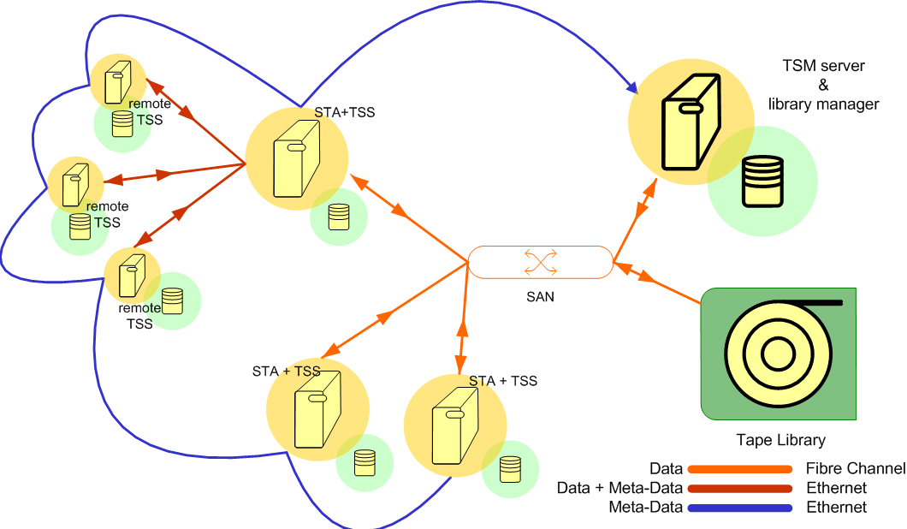
Archives with TSM

Slide 19
TSS
Interface directly with TSM via the API
Fan out for all dCache to tape activities
  multiple operations: recall, migrate, rename, delete, query
Runs on the TSM clients, storage agent or on the server proper
Plug-in replacement for the TSM backend that comes with dCache
Sends different type of data to different tape sets
Queues recall requests on tape sequence order
Allows to store an exact image of the logical global name space on tape
command line interface to set running parameters, monitor the processing, run db queries (think of it as an alternative dsmc)

Slide 20
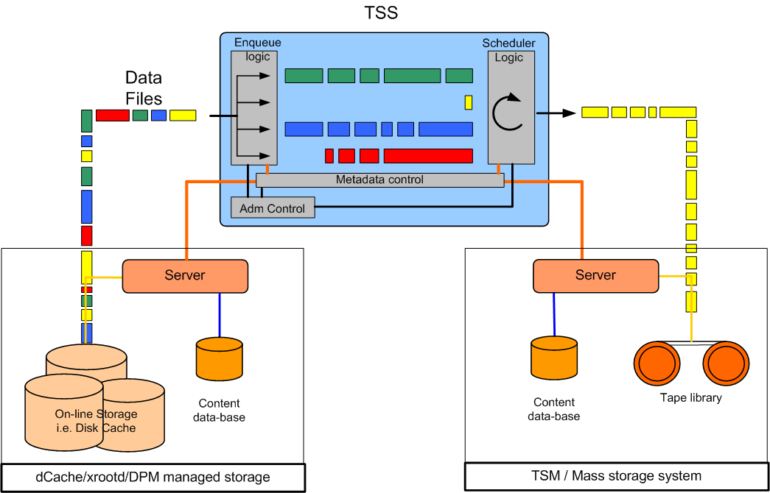
TSM staging server (TSS)

Slide 21
Enterprise removable media manager (eRRM)
Dynamic library and drive sharing across heterogeneous application boundaries and operating systems
Dynamic drive and cartridge pooling
Mount request queuing
Policy based drive and cartridge allocation
Policy based media life cycle management
Integrated off-site media management and tracking (vaulting)
Centralised access control, administration and reporting
Advanced reporting and auditing

Slide 22
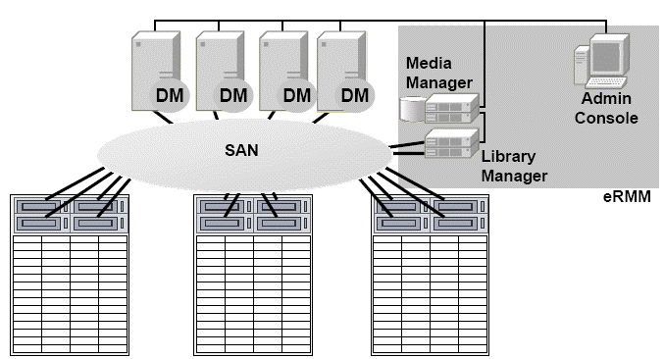
eRMM architecture
  Controls drives on behalf of the media manager
  Command line GUI
  Controls libraries on behalf of the media manager
  Encapsulates library hardware
  Coordinates access to drives and cartridges
  Central repository
  Log of all activities
  Libraries and drives

Slide 23
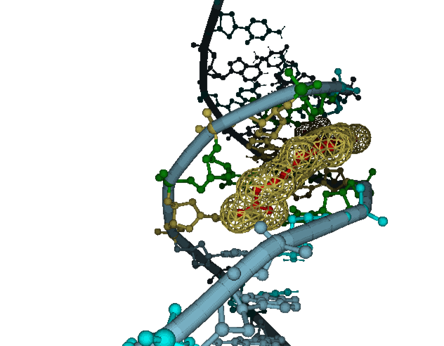
Other KIT customers (besides LSDF and GridKa)
LSDF DIS
  images, biology, materials research
  small files, access via gftp, sftp, GHI/VFS
BioQuant
  images, genetics data
  currently 4000 TB: backup via TSM
  input as is (small files!!)
HLRS
  1 - 2 PetaBytes yearly from 2015
  users can and must tar data
Libraries and State Archives
  file upload via web tools
  expect several hundreds of TB per year

Slide 24






Services
2
HPC at KIT
6
3
LSDF/hgf
GPFS
LSDF/hgf
SONAS
LSDF/bw
SONAS
5
8 x 10 GE
Campus BackBone
3 x 10 GE
40 GE
Cisco Nexus
Cisco Nexus
State of Baden-Wuerttemberg
Internet
4 x 10 GE
100 GE
4
BQ
1
Cisco 6500
WLCG

Slide 25
Update to Growth plans 2014 – 2016
Preliminary. Not valid until 1.8.2014
Project | Size PB | File Size Range | Growth PB/a | Client | Comment
HLRS | 1 | > 2 GB | 1 | scp | can use TAR
GridKa | 12 | > 2 GB | 2 | API | need queuing
LSDF-DIS (=HGF) | 3 | < 200 MB | 2 | gFTP | *)
LSDF-Heidelberg | 4 | < 200 MB | 1 | gFTP | *)
LSDF-EUDAT/HBP | 1.5 | < 200 MB | 0.5 | API | Object Storage
LSDF-State BW | 0.5 | < 200 MB | 0.5 | GHI | SONAS/NAS
KIT HPC | 2 | < 200 MB | 0.5 | API | Lustre HSM
*) a web based upload tool is being developed

Slide 26
HPSS Archive Project at KIT
Project start is 1.1.2014
  the HPSS project will not use the full installed capacity from the beginning. Instead project are added one after the other. Preparations for adding a KIT project to HPSS may run in parallel. Adding projects must be done the sooner the better. Hard deadlines are depicted below in the list of deliverables.
  we will add hardware (movers, cache space) as needed.
  Q3 and Q4 will be used to become familiar with the system, run tests, try out different clients and setups etc. KIT expects HPSS support when performing these trials. During Q4 the system will become production ready (KIT production readiness requires several formal steps to be taken)
Deliverables (resource requirements are estimates that must be adapted ‘in situ’)
  HPSS (production and test) ready for use: 1.7.2014
  Accept and store data from HPSS at HLRS: 1.1.2015
    the exact requirements will be determined the coming months.
    KIT and HLRS will involve HPSS support for finding an optimal solution
    2 to 10 drives LTO5
  Archives for BQ: 1.2.2015
    2 to 10 drives LTO
  GHI on LSDF/hgf: 1.3.2015
    2 to 6 drives LTO
  Migration from GridKa to HPSS start: 1.6.2015
    10 – 15 drives LTO for migration
    20 – 50 drives for production workload

Slide 27
HPSS discussion topics
GHI
Tape in the storage hierarchy adding storage class memory
  combine object oriented storage to tape
LTFS
  can this format be used for tape archives and replace the HPSS format
Large Media
  how to effectively handle >> 100 TB media
Queuing HPSS requests
  reading tape is 30% of TSM
Replacements (some of the) backups
  LSDF-DIS has 3000 TB
Replacing TSM in GridKa
  connection from dCache and xrootd to TSM
  2 approaches to the solutions
  via API or GHI (I'm striking VFS because I do not think that is a viable solution).
  infos from IN2P3 and BNL can serve as template
  use FUSE?

